Slide 1


Robotic 595R
TILT SENSOR INTEGRATION
OFF-ROAD APPLICATION
Mani Saeidi, Matt Gordon

Slide 2
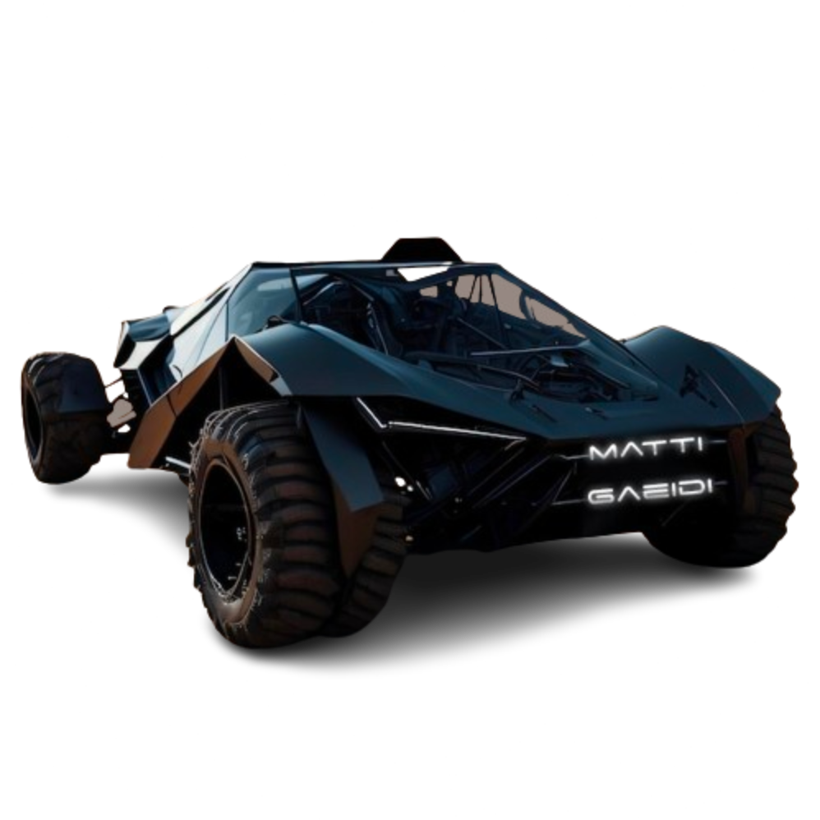
The Mission
Features:
Tilt Sensors
Warning LEDS.
Alternative Routes.

Slide 3

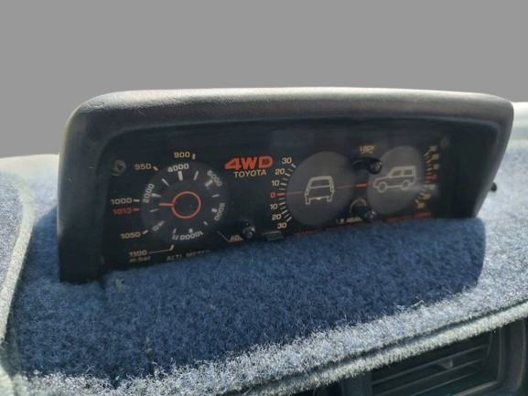
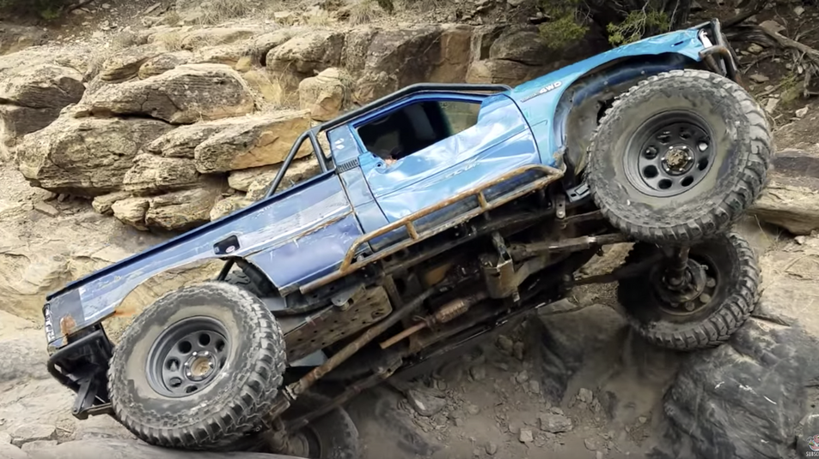
Off-road Background
Used in 4x4 vehicles for many years for off-road driving.
Simple bubble level mounted on the dashboard, providing a basic indication of the vehicle's inclination.

Slide 4
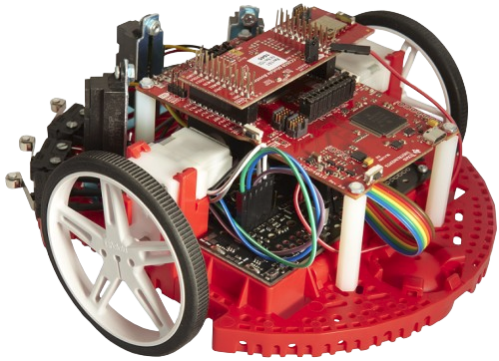
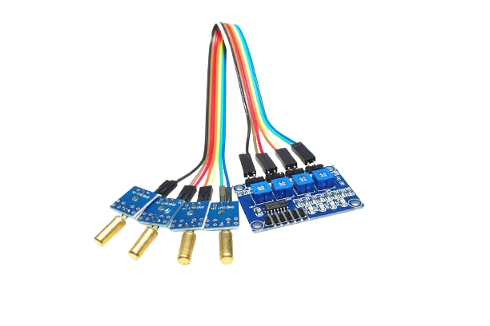
Essential Components
Tilt Sensor
Sensitivity Pots
MSP432 on TI Robotics Kit
Notes:
This utility drone, will illuminate trails and points of interest using a remote controller. Video transmission may be considered. The drone shall avoid both stationary and moving obstacles with it's proprietary hardware code. This technology can be used for emergency, military, or civilian use.

Slide 5
Plans
Original Plan: GPIO with Interrupts
Change in Plan: GPIO with Polling
Notes:
Using polling where we wait for the device to do a status check instead of an interrupt sending a signal and activating the NVIC whenever there is a flicker.
Simpler mechanism than interrupts to implement and we didn't want constant interrupts if there was flickering between which sensor was being activated at the time due to calibration issues
Future Development: Multiple Cores: Have multiple cores for polling if additional sensors onboard Create a counter or timer for the flickering Automatic Terrain Tracking (Notices if road is off pitch for turns)
[12:35 AM]pikA+:
i dont get it

Slide 6
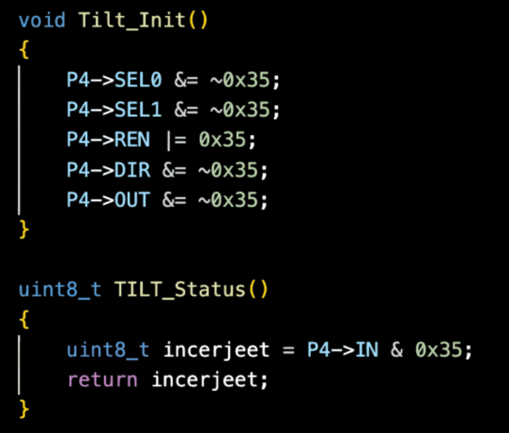
Program Implementation
GPIO Pins Utilized on Robot:
P4.0, P4.2, P4.4 & P4.5
P4.0 = 0x01
P4.2 = 0x04
P4.4 = 0x10
P4.5 = 0x20
= 0x35
+__________________

Slide 7
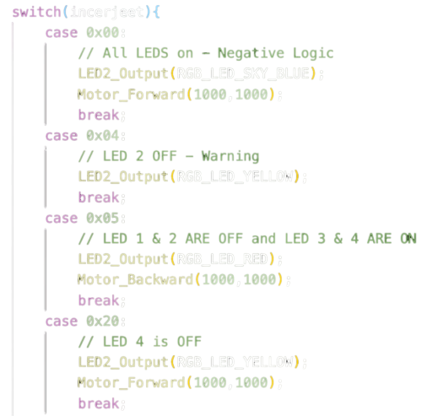
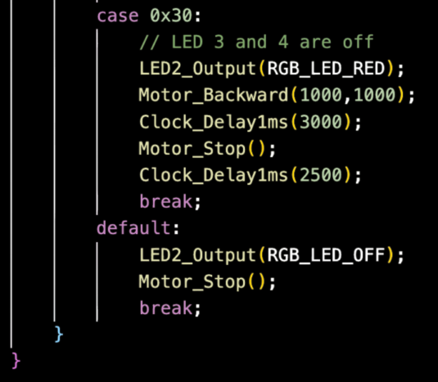
Program Implementation
Notes:
Different operations for which pins were active low

Slide 8
Demonstration
Video Demo LINK: https://youtube.com/shorts/D-K7hyaTdIc

Slide 9

Issues We Ran Into
LEDs displayed the opposite of the expected behavior.
Flickering of sensor due to calibration issues.
Notes:
ssues we ran into:
LEDS of the tilt were on when status of pin was off Flickering of the LED sensor - fixed with a delay although
it wouldve been better to use a debouncer-like system

Slide 10

Future Development
Multiple Cores
Systick Counter to Fix Flickering
Automatic Terrain Tracking
AI Crawl Control
Notes:
Multiple cores since multiple sensors on future vehicles to handle polling easily instead of waiting for each sensor one by one
Counter can fix flickering so that the operation is only performed if the sensor is active for a certain amount of time

Slide 11


Sources

Slide 12


MATTI GAEIDI
Conquer Terrain with Ease,
Anywhere That You Please!
Unlike these presentations,
our inclinometer will keep you level-headed.
Mani Saeidi
Matthew Gordon

